Slide 1

Predicting market segments of E-Commerce consumers based on their profitability using Clustering and Classification Methods
IS424 G2T7
Amir, Daniel, Jaye, Helisa, Subhashini, Jasmine
Notes:
Hi everyone, we are group 7 and today we will be presenting on Predicting market segments of E-Commerce consumers based on their profitability using Clustering and Classification Methods

Slide 2
Agenda
Introduction, Problem Statement & Motivation
Datasets
Results and Discussion
References
Literature Review
Methodology
Conclusion and Future Work
1
3
5
7
2
4
6
Notes:
This is the agenda of our presentation

Slide 3
Introduction & Motivation
Current Landscape: SEA Digital Economy projected to reach $1T GMV by 2030
Effective Customer Segmentation and Value Prediction is a key competitive advantage
Pandemic acted as a catalyst for users to increase amount spent and frequency of use of online platforms.
New challenges:
Larger, less homogenous consumer base
Created new channels that retailers have to allocate resources to, to attract consumers
Erratic demand & pricing with multiple competing sales campaigns (10.10, 11,11)
Merchants that want to thrive must meet the rising expectations of a wide range of consumers
Source: Google, Bain, & Temasek. (2021, November 10). E-conomy sea 2021.
Notes:
Moving on to our current landscape, the digital economy is becoming more and more profitable, especially after the pandemic which has boosted the number of people as well as the amount spent on online platforms. In fact, the South East Asian digital economy is projected to reach 1t gross merchandise value by 2030
This has created new challenges where there is now a larger, less homogenous consumer base which means that new channels have to be created in order to attract these customers and meet their growing expectations
This bring me to our motivation which is that effective customer segmentation and value prediction is a key competitive advantage

Slide 4
Current Process of Segmenting Consumers
Challenges of the process
Static Analysis
Segmentation only performed once
Require whole clustering model to be ran again to classify new customers or reclassify existing customers with new purchases
Inefficient
Data
No Predefined Consumer Segments
Segment based on Business Judgement
Segment Based on Clustering Algorithms
OR
Defined Consumer Segments
Analyze segments to drive business strategies
Notes:
Here we can see the current process of segmenting customers. Consumers are segmented based on business judgment or clustering algorithms by more technologically advanced firms. After which, customer segments are defined and analysed to derive business strategies.
However, this segmentation and analysis is only performed once and the clustering model need to be ran again to classify new customers which is inefficient.

Slide 5
Proposed Process of Segmenting Consumers
Data
No Predefined Consumer Segments
Segment Based on Clustering Algorithms
Re-cluster consumers when there is sufficient change
Defined Consumer Segments
Build Classification Model
Analyze segments to drive business strategies
Classify new customers based on predefined segments
Notes:
Instead, our proposed solution builds a classification model using the defined consumer segments this allows the business to dynamically assign a segment to new customers without running an entire model again. The business can choose to re-run the clustering algorithm when there is sufficient change in their consumer base.

Slide 6
Problem Statement
Construct a more dynamic & efficient process of segmentation via the combined use of clustering and classification algorithms, enabling firms to predict the value segments of their consumers more responsively
Notes:
With that we arrive at our problem statement that is to construct a more dynamic & efficient process of segmentation via the combined use of clustering and classification algorithms, enabling firms to predict the value segments of their consumers more responsively

Slide 7
Literature Review
Notes:
To answer this, we conducted literature review and I will be sharing the summary now.

Slide 8
Summary of our Literature Reviews
Review 1: An Empirical Study on Customer Segmentation by Purchase Behaviours Using a RFM Model and K-Means Algorithm Review 2: Data accuracy's impact on segmentation performance: Benchmarking RFM analysis, logistic regression, and decision trees Review 3: A machine learning framework for customer purchase prediction in the non-contractual setting
Motivation (Why we chose these reviews): Review 1: Gave us the assurance that RFM analysis is viable for customer segmentation. Gave us ideas on using K-means with RFM Review 2: Gave us an idea of Combining RFM with K-means clustering for further analysis Review 3: Gave us a clue on using date-time variables for new features | Techniques Covered: Feature engineering to form RFM variables K-Means Clustering PCA CHAID Decision Trees Direct RFM Segmentation Logistic Regression Lasso Logistic Regression (LASSO) Gradient Tree Boosting (XGBoost) Extreme Learning Machine (ELM)
Learnings: Learnt more about the nature of transactional data Learnt more about existing libraries and its functions that we could use in our code EDA processes on Transactional data Data mining techniques that gave us an initial start on the project | Further research that needed to be done : Limitations of K-means Limitation of K-modes K-Prototype clustering Determining which cluster technique is the best for our data Proceeding with classification after labelling our data with “Pseudo labels” based on our clustering analysis
Notes:
3 literature reviews were mentioned during our project proposal, which are stated at the top. I will now be sharing the motivation for choosing them. The first lit review gave us the assurance that RFM analysis is viable for customer segmentation. The second review gave us an idea of combining RFM with k-means clustering. Lastly, the third review gave us a clue on using date time variable for new features.
Moving on to takeaways, We learnt more about transactional data, data mining techniques and the function of existing relevant libraries as well.

Slide 9
Datasets
Notes:
Thank you Subha, now moving onto the dataset.

Slide 10
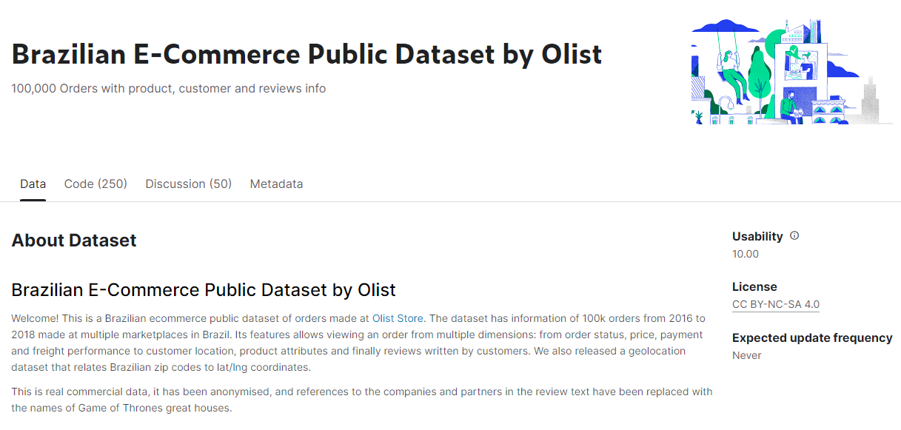
Dataset
Brazilian E-Commerce Public Dataset by Olist , Source: Kaggle (Link)
Olist is the largest department store in Brazilian marketplace
The dataset has information of 100,000 orders made at multiple marketplaces in Brazil.
Date: 2016 to 2018
An order can be viewed from multiple dimensions
Order status
Price and Payment
Freight performance to customer location
Product attributes
Reviews written by customers
Geolocation that relates Brazilian zip codes to latitude / longitude coordinates.
Notes:
We originally extracted the Brazilian E-commerce by Olist dataset from Kaggle. Olist is the largest department store in the Brazilian marketplace and the dataset has information of 100,000 orders made at multiple marketplaces from 2016 to 2018. An order can be viewed from multiple dimensions such us, order status, price and payment and product attributes.

Slide 11
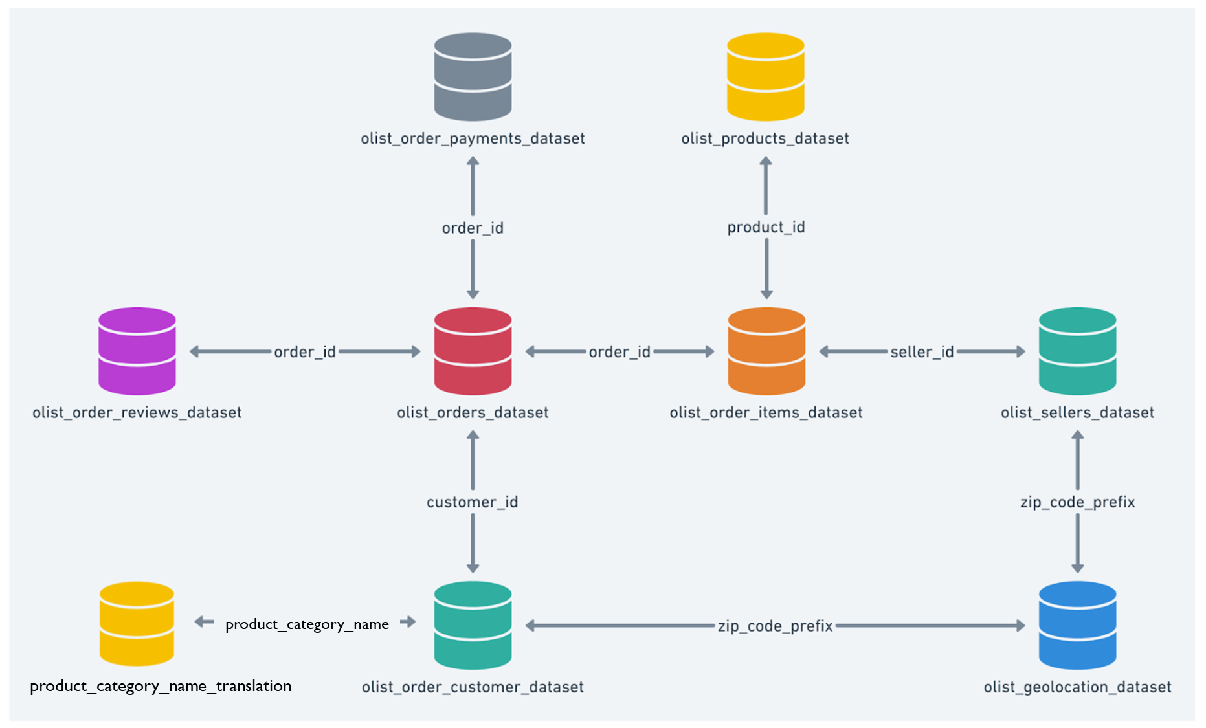
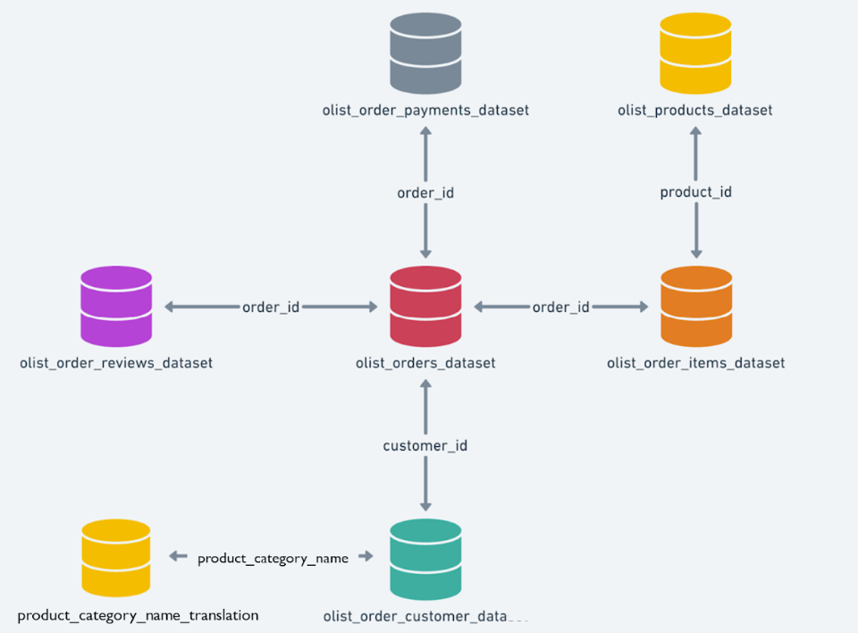
Data Schema
Original
Preliminary
Notes:
With the original data schema that we have which has 9 dataset, for our project, we decided to only use 7 of them.

Slide 12
Dataset Attributes
Dataset | Attribute | Description | Example
Customer | Customer ID | Key to the orders dataset. | customer_id: 9ef432eb6251297304e76186b10a928d
 | Customer_state | Customer’s state | customer_state: SP
 | Customer_unique_id | Unique identifier of a customer. | customer_unique_id: 861eff4711a542e4b93843c6dd7febb0
Order Payments | Order ID | Unique identifier of the order. | order_id: e481f51cbdc54678b7cc49136f2d6af7
 | Payment Type | Method of payment chosen by customer. They can choose more than 1 payment types for each purchase. | credit_card_payment_type: 1.0 voucher_payment_type: 0.0 boleto_payment_type: 0.0 debit_card_payment_type: 0.0
 | Payment Installment | No. of installments chosen by the customer | payment_installments: 1
 | Payment value | The transaction value. | payment_sum: 38.71
Notes:
These are the dataset attributes that we will be using. The main changes in our dataset attributes from the previous presentation and now is that we added a new attribute in the customer dataset. We have the customer unique id which uniquely identify the customer.
For the dataset attributes, there is no changes from the previous presentation, however, we added 1 more dataset which is Review dataset anthat we used since the project proposal presentation are the same but we added 2 new atThese are the following attributes that we will be using:
We have customer id which is key to orders dataset
We have customer state
We have customer unique id which is the unique identifier of a customer.
We have order id which is the unique identifier of the order
We have payment type that is chosen by the customer. They are 4 payment types - credit card, voucher, boleto and debit card. A customer can choose more than 1 payment types for each purchase. So in this example, 1 represents yes, the customer will be using credit card and 0 means no.
We have payment installment which is the no. of installments chosen by the customer
We have payment value which is the amount the customer needs to pay

Slide 13
Dataset Attributes
Dataset | Attribute | Description | Example
Orders | Order purchase timestamp | Customer’s purchase timestamp. | order_purchase_timestamp: 2017-10-02 10:56:33
Products | Product category name | The category name of the product. | product_category_name_english: housewares
 | product_category_name | The category names of the products in portuguese. | product_category_name: beleza_saude
Reviews | Review score | Note ranging from 1 to 5 (integer) given by the customer on a satisfaction survey. | Review score : 5
Notes:
We also added the product category names in portuguese under the product dataset and last we added a new dataset review with an attribute of review score ranging from 1-5 in integer given by the customer on a satisfaction survey.

Slide 14
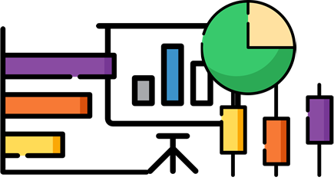
Data Preprocessing
Notes:
Next, daniel and i will be talking about the data preprocessing & EDA.

Slide 15
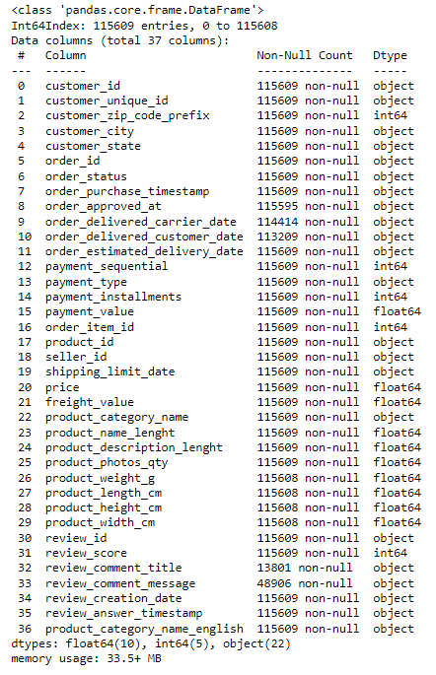
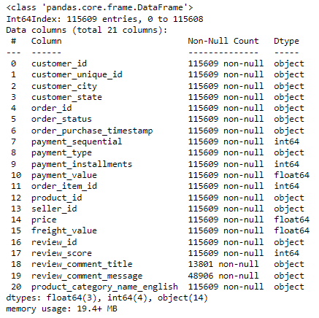
Data Preprocessing (Feature Selection)
Notes:
For our data preprocessing, with our current dataset, we did a feature selection from 37 columns originally to 21 columns.

Slide 16
Data Preprocessing (Feature Engineering)
Data after Feature Selection: 115609 rows, 21 columns
Remove any duplicated data
One hot encoding for payment type column
Changing datatypes
Data after Feature Engineering: 93395 rows, 14 columns
Aggregating at customer level (customer_unique_id)
Creating new columns: Order Recency, Frequency and Monetary, Most Expensive Product Category
Notes:
To further explain, each row represent one transaction and with our goal in mind to predict which customer segment a particular customer belong to, we need to transform our dataset to display customer level. Furthermore, out lit review that we have researched and analyzed on showed many case studies leveraging on customer level. Hence, we removed any duplicated data and did a one hot encoding for payment type to allow aggregation and accurate capturing of multiple types from a particular customer.
We also added new columns which are Order recency, frequency, monetary and most expensive product category.

Slide 17
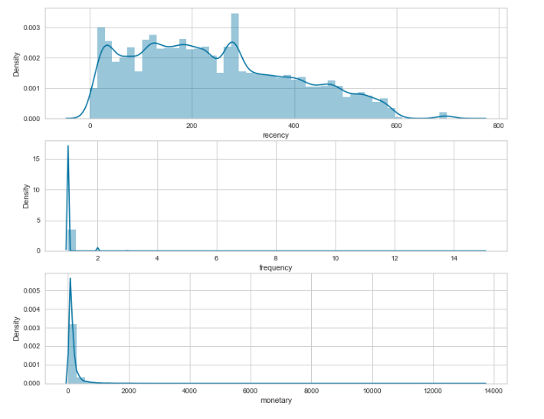
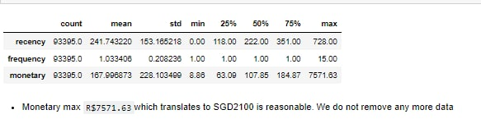
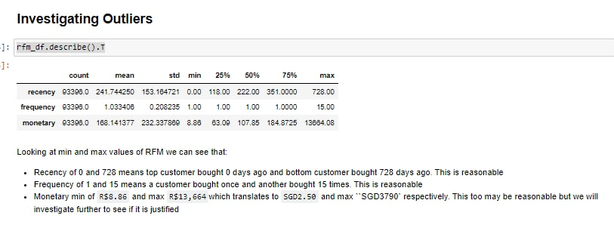
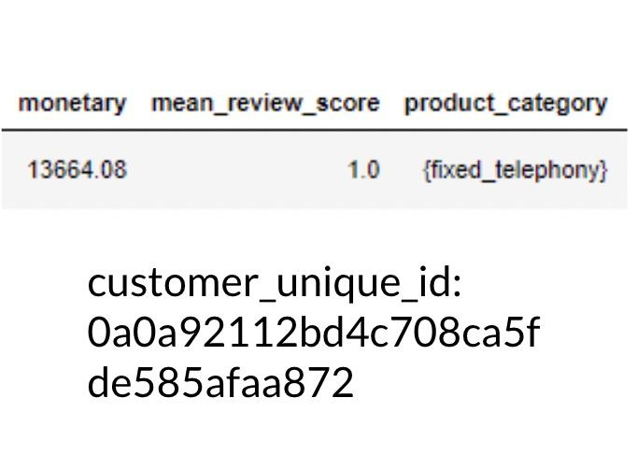
Data Preprocessing (Outlier Removal)
Removing Outliers based on RFM
Distribution of RFM
Interquartile Range (IQR)
Standard Deviation
Notes:
In continuation of our data pre processing, we removed any outlier that existed based on RFM, We first displayed the distribution for RFM and then used the inter quartile range and standard deviation methods of which this allows to identify the outliers. After investigating the outliers. In particular, looking at the monetary column which has a max purchased value of 3800SGD, we decided to remove this particular customer. Reason because upon looking at the product category of the customer’s purchase, the customer bought something in the fixed telephony category which refers to mobile devices and it is unlikely for one to spend so much on a phone. Moving on, daniel will talk about the EDA process.

Slide 18
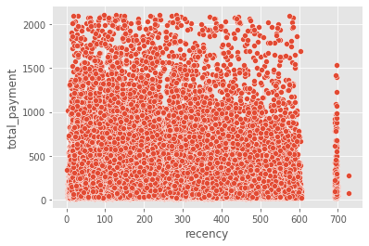
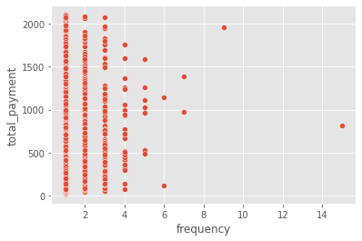
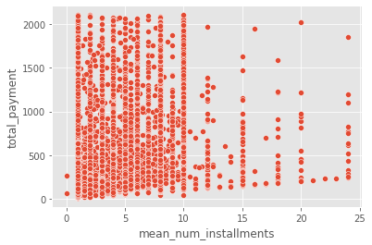
EDA - Visualizing the Data
There does not seem to be any obvious relationship between how recently the customer has visited the shop and their total amount spent
Most customers are not frequent repeat customers.
Most customers do opt for instalments for their payment. These instalments are mostly 10 or less.
Notes:
Thanks Helisa.
Moving on to our EDA, one thing we noticed was that most customers are not frequent customers.
There also did not seem to be any obvious relationship and for mean number of installments and total payment,
And we had some insights where most customers opted for instalments which were usually 10 or less.

Slide 19
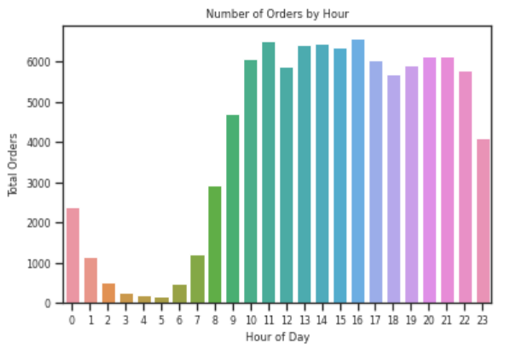
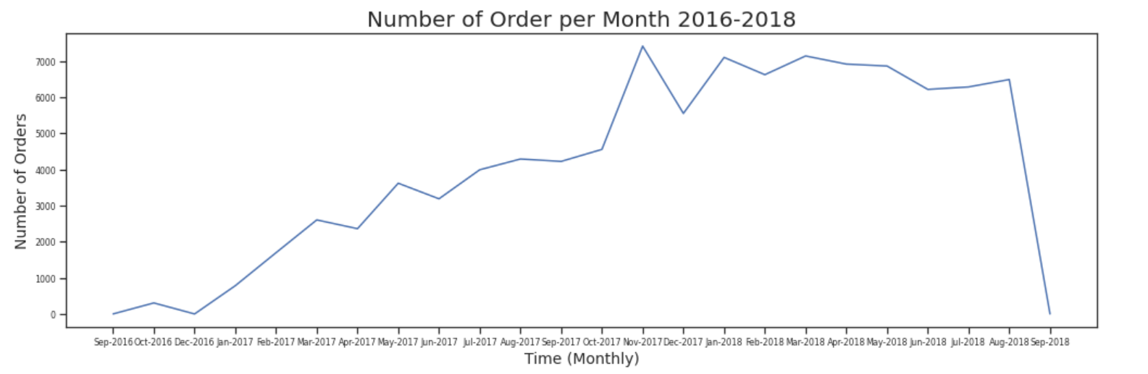
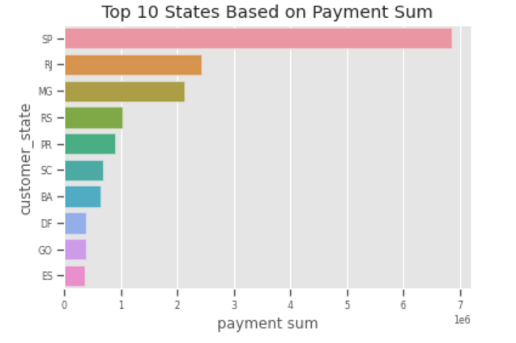
EDA - Visualizing the Data
Number of Orders per Hour
Number of Orders per Month
Top 10 States Based on Payment Sum
Notes:
Regarding orders per month, we saw an increase in orders from 2016 and these orders were usually placed between 9am-11pm which seemed reasonable.
The top states based on payment sum were Sao Paulo and Rio de Janeiro
Sao Paulo -SP
Rio de Janeiro-RJ

Slide 20
Methodology
Notes:
[daniel]
Moving on to our methodology,

Slide 21
Methodology
Business Methods
RFM Scoring
Start of Analysis
Consumer Segmentation
Label data using best model
Build classification model to label unseen data
Evaluate model & methodology
K-means
Data Mining Algorithms
K-Prototype
Notes:
[daniel]
So for our project, one of the main challenges was figuring out how we were going to find value segments for customers in our dataset, as well as defining what these “value segments” are. To tackle this, our group explored a business method of segmentation, called the RFM scoring as well as data mining clustering techniques such as K-means clustering and K-prototype clustering.
Amongst all these methods, we then chose the best clustering method to generate “pseudo labels” in our dataset which we later used for classification to ultimately predict which value segment a customer will fall into.
Im sure most of us are new to the term “RFM scoring” and “K-Prototype”, but dont worry because we will cover what they are very soon.

Slide 22
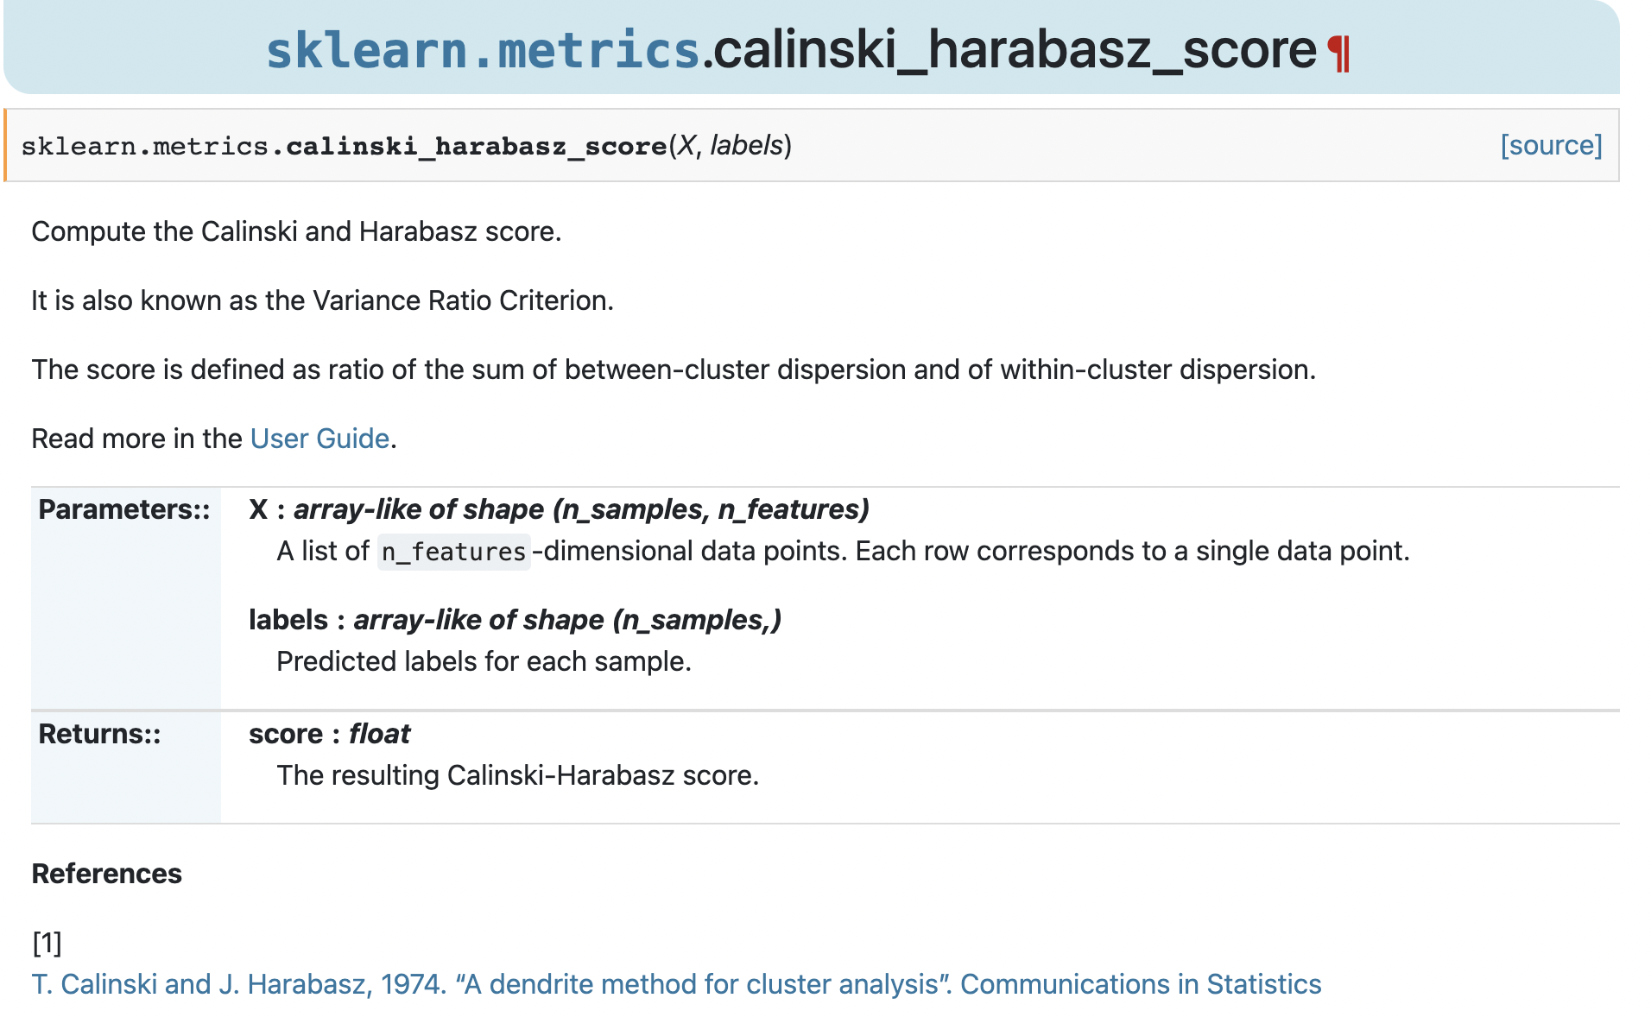
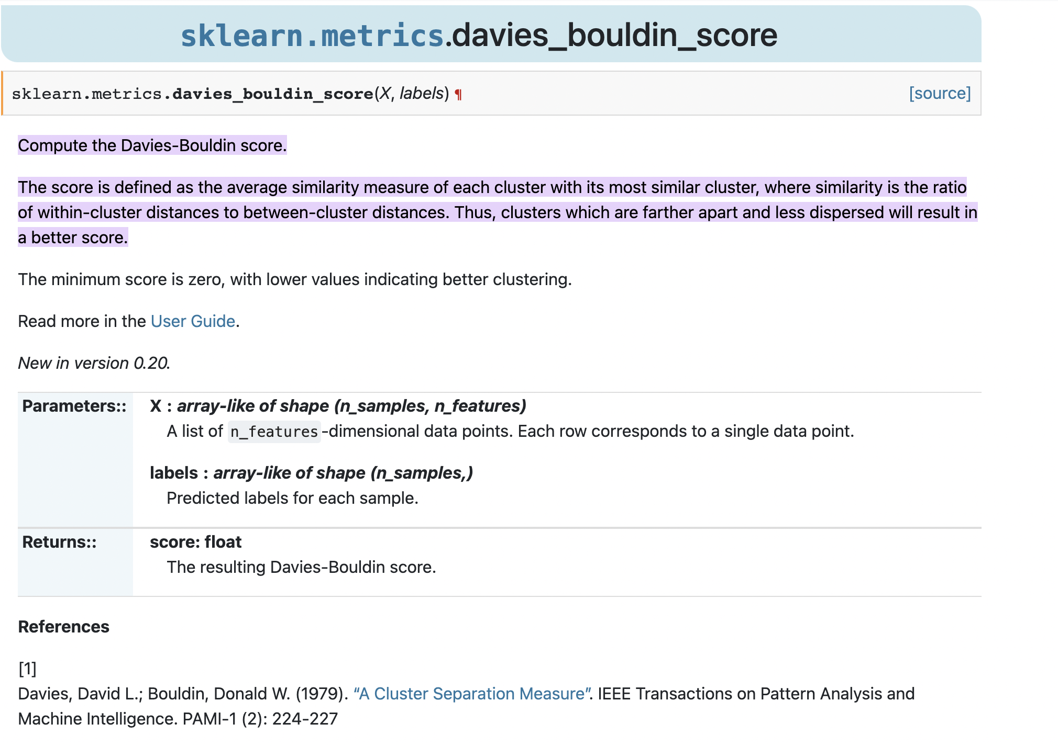
Additional Metrics for Clustering
Calinski Harabasz Score
Davies-Bouldin Index Score
Variance Ratio Criterion
Ratio of the sum of between-cluster dispersion and of within-cluster dispersion
Higher values = Better clustering
Average similarity measure of each cluster with its most similar cluster
Similarity = ratio of within-cluster distances to between-cluster distances
Notes:
[daniel]
Also, before moving on to our customer segmentation and clustering, our group wants to highlight two additional metrics besides SSE to evaluate our clusters based on clustering algorithms.
The first metric is the Calinski Harabasz Score which is the ratio of the sum of between-cluster dispersion and of within-cluster dispersion
To put it simply, higher values of the calinski score means better clustering because you want a higher value of between-cluster dispersion and a lower value of within-cluster dispersion.
The second metric would be the Davies-Bouldin Index Score which is defined as the average similarity measure of each cluster with its most similar cluster.
The similarity is the ratio of within-cluster distances to between-cluster distances. Thus, Lower values mean clusters which are farther apart and less dispersed which reflects better clustering

Slide 23
Consumer Segmentation
Notes:
[daniel]
Moving on to the consumer segmentation

Slide 24
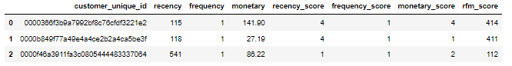
Segmentation- Business Methods: RFM Scoring
Feature Engineering
Assumption: Most valuable customer orders most recently, most frequently and purchases the most expensive items
Recency
Frequency
Monetary
No. days since last order
No. of orders
Total value of all orders
Quantile Based Discretization
Each customer is given a score of 1-5 for each bucket (Recency, Frequency & Monetary).
Scores are concatenated to give RFM score
Map RFM scores to Consumer Profiles
Each customer is then mapped to a customer profile based on their RFM Score and existing literature on RFM scoring
Notes:
[daniel]
The first method an existing business method called rfm scoring, with rfm standing for (recency, frequency, and Monetary).
Recency measures the number of days since our last order, frequency would be the number of orders a customer has made, and monetary is the total value of all orders.
Our group did feature engineering for these attributes and proceeded with quantile based discretization to give a score from 1-5 for these new features.
These score were then concatenated to give a final rfm score. So for example if we had a score of 4 for recency, 1 for frequency, and 4 for monetary, the final rfm value would be 414.
With these score, the customer was then mapped to a customer profile and these profiles were derived from existing literature from bloomreach

Slide 25
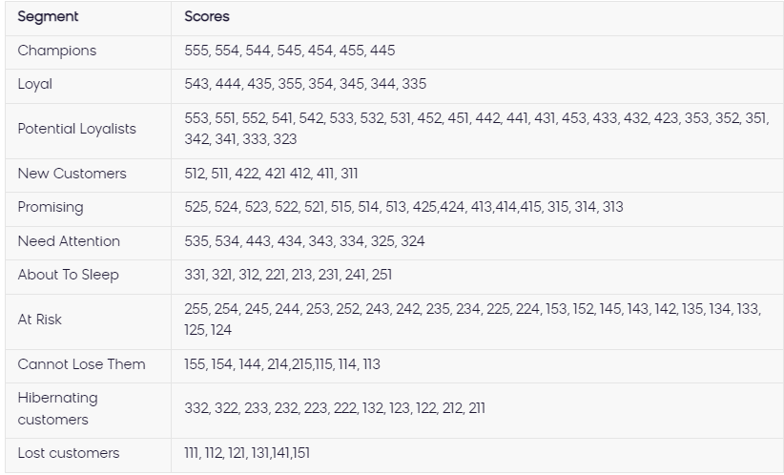
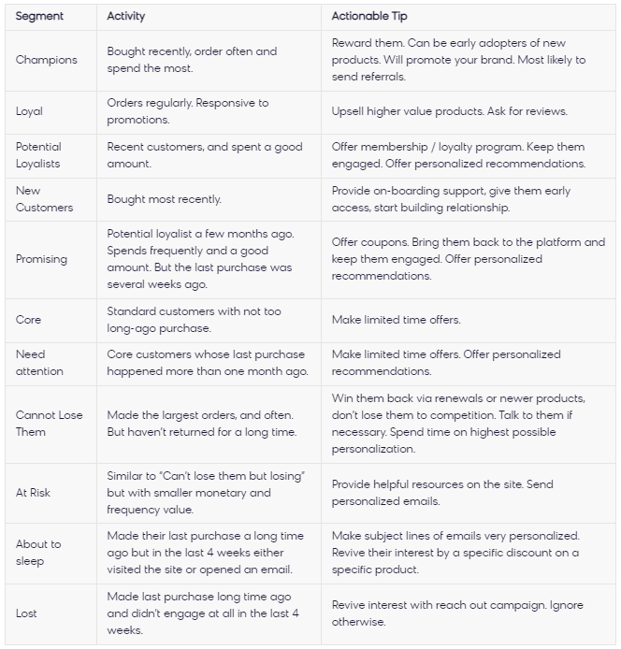
Segmentation- Business Methods: RFM Scoring
Map RFM Scores to Consumer Profiles
Source: Bloomreach. (n.d.). RFM segmentation. Engagement. Retrieved November 8, 2022, from https://documentation.bloomreach.com/engagement/docs/rfm-segmentation#rfm-segments
Notes:
[daniel]
This slide shows the profiles based on rfm scoring, and we put the link of the study in the bottom of the slide.
The study suggested the different customer segments as well as actionable tips for these segments
For example, Champion customers are those who has bought recently, often, and also spent a lot of money. What a business can do with this customer segment is to reward them and use them to promote their brand.

Slide 26
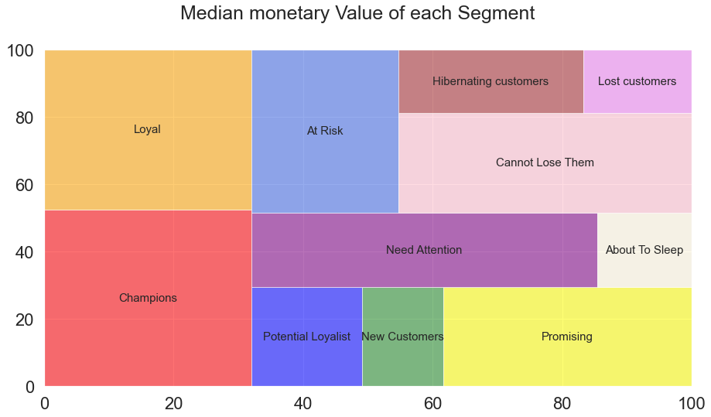
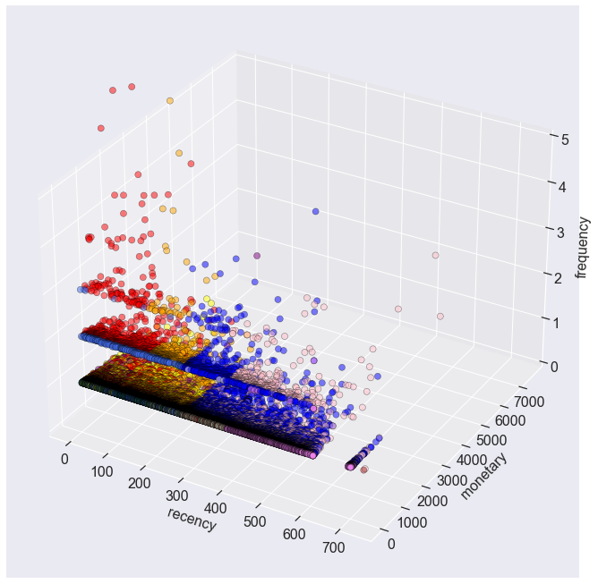
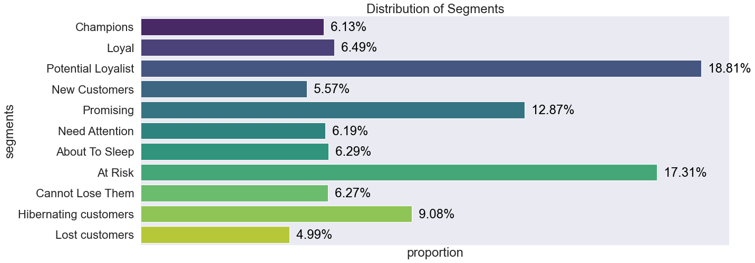
Segmentation - Business Methods RFM Scoring
Clustering Results
Pros
Cons
Computationally efficient to compute
Only requires 3 variables (RFM) that most companies have access to
Easy to interpret
Highly actionable
Force fits consumers into 11 fixed segments
Doesn’t take into consideration other variables
Eg. Satisfaction, Geolocation, other purchase preferences
Notes:
[daniel]
We used the same method on our dataset, and came up with these visualisations - a treemap of our customer segments based on median monetary value, a 3d scatterplot, as well as the distribution of these segments for our data.
One thing we could notice right away using this method is that our data consists mostly of potential loyalist customers - who are customers that have bought recently and spent a good sum. Based on this alone, business can have actionable insights such as offering membership and loyalty programs to keep them engaged.
With regards to pros and cons, the main advantage would be that the segmentation is easily interpretable, with backup existing literature which also leads to it being highly actionable. For disadvantage, the main one would be that there are 11 fixed segments, which may not be representative for all customer profiles

Slide 27
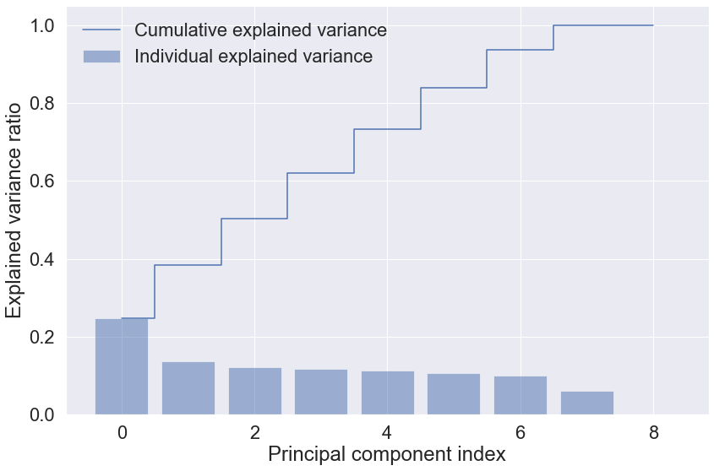
Segmentation- DM Methods: K-means Clustering
Feature Engineering & Feature Selection
Order Recency (R)
Frequency of Orders (F)
Total Monetary Value (M)
No. Payment Installments Required (Lower = Better Cash Flow for company)
Review Score (Proxy for customer satisfaction)
% of Purchases paid with Credit Card, Vouchers, Debit Card, Boleto
Normalization (StandardScaler)
PCA
Without PCA
Selected 6 PCs that explain 83.9% of total variation
Notes:
Moving on to segmentation using K-means clustering. K-means clustering is a centroid-based clustering algorithm, where we calculate the distance between each data point and a centroid to assign it to a cluster. The goal is to identify the K number of clusters that is optimum for our dataset.To do so, we performed feature engineering and feature selection. Order Recency, Frequency of orders and Total monetary values were selected, also known as RFM. Other selected features are Number of payment installments required, review score and percentage of purchases paid with credit card, vouchers, debit card and boleto. After which, we normalize the data and performed PCA. From the PCA results, 6 principle components were selected that explain 83.9% of the total variation.

Slide 28
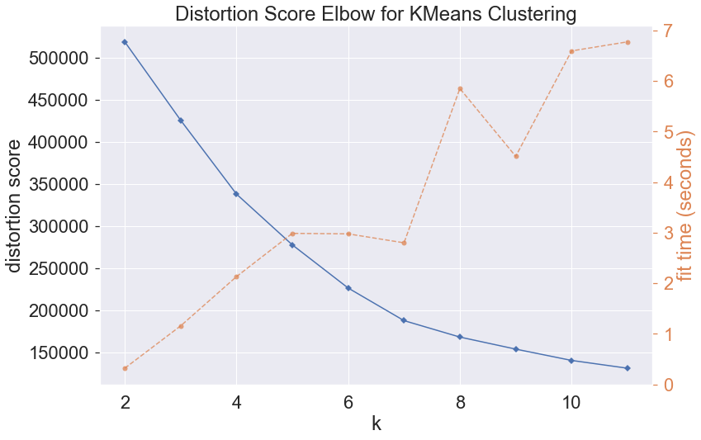
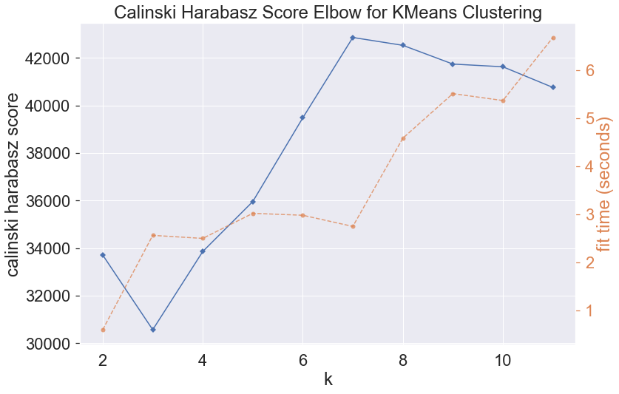
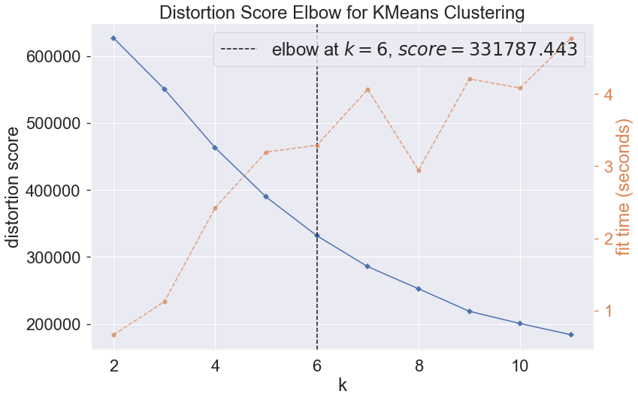
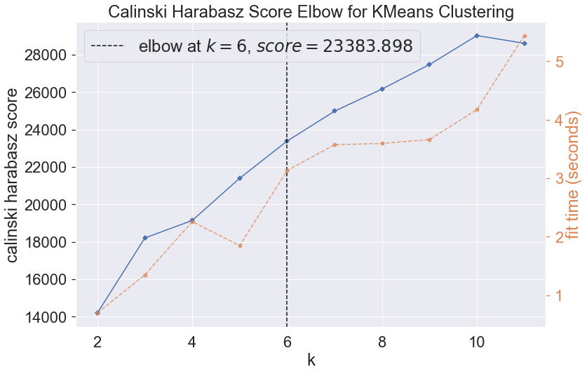
Segmentation - DM Methods: K-means Clustering
Find Optimal No. Clusters using Elbow Method
PCA
Without PCA
Optimal No. of Clusters: 7
SSE : 168,482.56
Calinski Harabasz Score: 42,531.24
Optimal No. of Clusters: 6
SSE : 285,694.80
Calinski Harabasz Score: 24,980.48
Select Best Model
K-Means Model with PCA Selected
Lower SSE
Higher Calinski Harabasz Score
Notes:
Next, we found the optimal number of clusters using Elbow Method. With PCA, the optimal number of clusters were 7, SSE was 168,482 and Calinski Harabasz score was 42531. On the other hand without PCA, the optimal number of clusters were 6, SSE was 285694 and Calinski Harabasz score was 24980. By comparing the results with PCA and without PCA, we selected the K-means model with PCA as it had a lower SSE and higher Calinski Harabasz score.

Slide 29
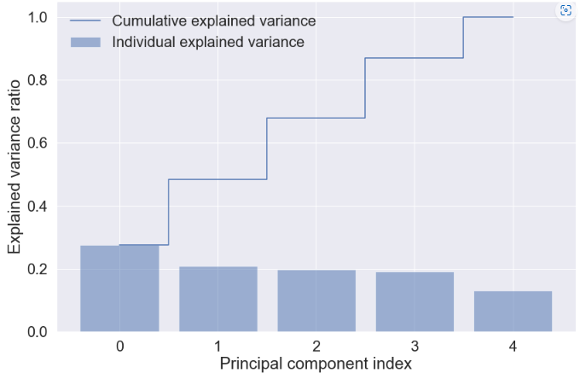
Segmentation - DM Methods: K-Prototype
Feature Engineering & Feature Selection
Continuous Variables
Categorical (Nominal) Variables
Recency
Frequency
Monetary
Review Score
No. Installments Required
Payment Methods: Credit Card, Voucher, Boleto & Debit Card (1: Used, 0: Never Used)
Customer State
Most Expensive Product Category Bought
Normalize Continuous Variables
PCA on Continuous Variables
Selected 4 PCs that explained 87.0% of variation
Notes:
We also performed segmentation using K-Prototype which is a hybrid clustering algorithm that can process Categorical Data and Numerical Datas. Our gorup wanted to analyse the categorical variables of our dataset and used K-Prototype to do so.
During feature selection, the continuous variables selected are recency, frequency, monetary, review score and number of installments requires. While the Categorical variables are payment methods such as Credit Card, Voucher, Boleto & Debit Card (1: Used, 0: Never Used), Customer state and most Expensive Product Category Bought. We then Normalised the continuous variables and performed PCA on them. From which, 4 principle components were selected that explained 87% of variation.

Slide 30
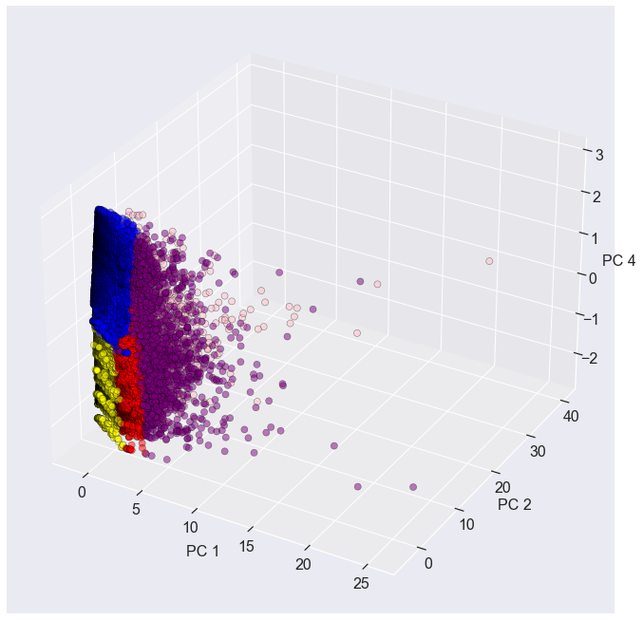
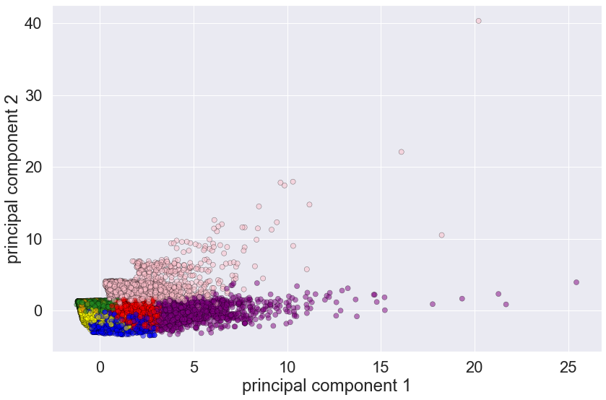
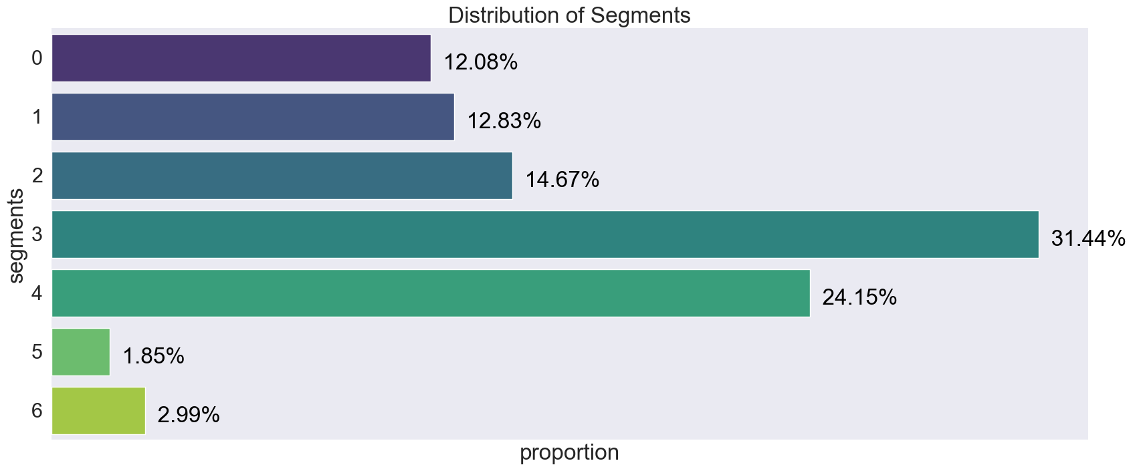
Segmentation - DM Methods: K-Prototype
Select No. Clusters
Model Runtime on 93k rows, 10 columns: 41 minutes
Due to extremely long runtime, optimal no. clusters selected based on previous K-Means model (k=7) and not through elbow-method
Clustering Results
Calinski Harabasz Score: 33,828.89
Davies-Bouldin Index Score: 1.68
Notes:
Next, we attempted to select the optimal number of clusters. However, we faced an issue of long runtime, whereby, the model runtime on 93k rows and 10 columns was 41 minutes. Thus, we selected the optimal number of clusters based on the previous k-means model where k = 7 and not through the elbow-method. Moving on to the clustering results, the calinski Harabasz score was 33828 and the Davies-Bouldin index score was 1.68.

Slide 31
Comparing the 3 Methods
RFM Scoring
K-Means
K-Prototypes
Calinski Harabasz Score
4590.05
68,547.81
33,828.89
Davies-Bouldin Index Score
4.34
0.74
1.68
Pros
Easy and efficient to compute
Only requires 3 variables
Easy to interpret
Highly actionable
Better notion of vector space quantization
Incorporates RFM variables along with other continuous variables
Better notion of vector space quantization
Able to utilize both numerical and categorical data
Cons
Force fits consumers into 11 fixed segments
Doesn’t take into consideration other variables
Eg. Satisfaction, Geolocation, other purchase preferences
Doesn’t take into account categorical variables
Clusters more difficult to interpret
Less actionable
Extremely long runtime
Clusters more difficult to interpret
Less actionable
Notes:
Next, let's look at how the 3 models compare. The models are evaluated based on Calinski Harabasz score and Davies-Bouldin Index score. The RFM scoring has the lowest Calinski Harabasz score while the K-means clustering has the highest Calinski Harabasz score. On the other hand, the RFM scoring has the largest Davies-Bouldin Index score while the K-means has the lowest Davies-Bouldin Index score.
Additionally, each method has its own pros and cons. Starting with RFM scoring, it was easy and efficient to compute, only requires 3 variables and easy to interpret and also highly actionable. However, it force fits consumers into the 11 fixed segments. It also does not take into account other variables such as satisfaction, geolocation and other purchase preferences.
Moving on to K-means, its advantages includes, better notion of vector space quantization and incorporates RFM variables along with other continuous variables. However, it does not take into account categorical variables, clusters are more difficult to interpret and it is less actionalable.
Lastly, K-prototype is a better notion of vector space quantization and it is able to utilize both numerical and categorical data. However, it has an extremely long runtime, the clusters are more difficult to interpret and it is less actionable.

Slide 32
Final Clusters
 | customer_state |  | recency | frequency | monetary | mean_review_score | boleto | credit_card | debit_card | voucher | most_exp_category
Cluster | count | mode | median | median | median | mean | mean | mean | mean | mean | mode
0 | 21681 | SP | 395.0 | 1.0 | 125.520 | 4.618814 | 0.000000 | 0.999962 | 0.000000 | 0.000038 | bed_bath_table
1 | 33658 | SP | 137.0 | 1.0 | 92.780 | 4.625780 | 0.000000 | 0.999990 | 0.000000 | 0.000010 | health_beauty
2 | 18190 | SP | 235.0 | 1.0 | 93.835 | 4.106982 | 0.999973 | 0.000000 | 0.000027 | 0.000000 | health_beauty
3 | 3462 | SP | 246.5 | 1.0 | 86.730 | 4.075371 | 0.002672 | 0.282700 | 0.000241 | 0.714388 | bed_bath_table
4 | 1422 | SP | 130.0 | 1.0 | 89.690 | 4.175457 | 0.000000 | 0.000000 | 1.000000 | 0.000000 | health_beauty
5 | 3937 | SP | 186.0 | 2.0 | 464.070 | 4.179021 | 0.103379 | 0.880160 | 0.005503 | 0.010958 | bed_bath_table
6 | 11045 | SP | 210.0 | 1.0 | 133.380 | 1.477139 | 0.000000 | 0.999743 | 0.000000 | 0.000257 | bed_bath_table
Cluster | Customer Profile
0 | Lost Customers: Haven’t purchased in a year
1 | Core: Highly satisfied, Average Spending, Pay mostly using Credit Card
2 | Boleto Users: Purchase mainly using boleto, average spending, purchased relatively long ago
3 | Bargain Hunters: Purchase using vouchers
4 | Promising: Satisfied customers that purchased not too long ago
5 | Champions: (Most Valuable Segment ) Spends the highest, most frequently. Satisfied and mainly purchases with credit card
6 | Dissatisfied Customers
Notes:
Here, we can see the final clusters and the customer profiles of the customers. Cluster 0 refers to the lost customers who have not purchased in a year. Cluster 1 refers to core customers who are Highly satisfied, Average Spending, Pay mostly using Credit Card. Cluster 2 refers to Boleto Users who mainly Purchase using boleto, average spending, purchased relatively long ago. Cluster 3 refers to Bargain Hunters who Purchase using vouchers mainly. Cluster 4 refers to Promising customers who are Satisfied and purchased not too long ago. Cluster 5 refers to the Most Valuable Segment known as Champions. They Spends the highest, most frequently, are Satisfied and mainly purchases with credit card. Lastly we have cluster 6 which refers to Dissatisfied Customers.

Slide 33
Classification

Slide 34
Classification Model Approach
Real World Scenario
Our Approach
Existing Data
Dataset
Obtain Cluster Labels
Pseudo Ground Truth
Obtain Cluster Labels (Cluster 1) for entire dataset
Build Classification Model
Train Dataset
Test Dataset
Classify new data/customers to defined labels
Obtain Cluster (Cluster 2) Labels from train dataset only
In a real-world application of this process, there is no way to evaluate the classification model by comparing labels
Build Classification Model
Compare Cluster 2 & Cluster 1 in test set
Classify test data into identified cluster labels
Notes:
In a real world scenario you would simply cluster your existing consumers, obtain the cluster labels, build a classification model and use it to classify any new data or customers. However, there is no way to measure the accuracy of this classification model. As such, we first start by clustering the ENTIRE data set to obtain Cluster 1 which acts as a Pseudo Ground Truth. We then divide the data into Train and Test set. The train data set is akin to the existing data in the real world scenario. We cluster this data to obtain the labels and build a classification model. We then apply the classification model on the test dataset which is akin to new data in a real world scenario. However, in our case we can now compare the cluster labels output by the classification model (cluster 2) with Cluster 1 which allows us to evaluate the classification model.

Slide 35
Classification Model Approach
 | Attribute 1 | Attribute 2 | Attribute …
Cluster_1
Pseudo Ground Truth
Notes:
For our classification models, we have to train our model

Slide 36
Classification Model Approach
Pseudo Ground Truth
 | Attribute 1 | Attribute 2 | Attribute …
Cluster_1
0
1
5
4
2
Cluster 2
3
1
3
4
2
Training Data
6
2
0
To be predicted by the model
Test Data
Notes:
We did not create the model based on all the rows of data but instead ⅔ only so the remaining ⅓ is the unseen data (! change the cluster_1 column)

Slide 37
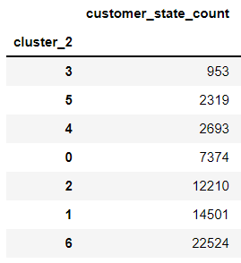
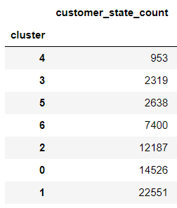
Re-mapping the clusters
Since we are not able to simply instruct the K-Means implementation to use the same names for the clusters each time, we will remap the clusters using the cluster size as a proxy
Clusters from training data
Pseudo ground truth clusters
Mapping:
Cluster 3 → 4
Cluster 5 → 3
Cluster 4 → 5
Cluster 0 → 6
Cluster 2 → 2
Cluster 1 → 0
Cluster 6 → 1
Notes:
After we obtain the cluster labels from the training data, we will need to re-map the clusters because the cluster labels may change since we are unable to instruct the K-means implementation to use the same names for the clusters each time. In this case, we will be using the cluster size as the proxy so cluster 3 derived from the training model is now mapped to cluster 4 from the pseudo ground truth.

Slide 38
Decision Tree & Random Forest Classification
Features (X)
Customer_state, recency, frequency, monetary, mean_review_score, mean_num_installments, boleto, credit_card, debit_card, voucher, most_exp_category
Target (Y)
Segments/Clusters: 0, 1, 2, 3, 4, 5, 6 (total 7 clusters based on the clustering done previously)
Models
Decision Tree
Random Forest
Accuracy: 0.89179
Precision: 0.89179
Recall: 0.89179
F1-Score: 0.89179
Accuracy: 0.99088
Precision: 0.99088
Recall: 0.99088
F1-Score: 0.99088
Notes:
Firstly, we ran the decision tree classification model with 11 attributes in X and for our target Y, it will be class labels derived from the clustering done previously. It has an accuracy, precision, recall and f1 score of 0.89179. We tried a second classification model - Random Forest that produced a better results from the decision tree with a score of 0.99088.

Slide 39
XGBoost Classification
Features (X)
Customer_state, recency, frequency, monetary, mean_review_score, mean_num_installments, boleto, credit_card, debit_card, voucher, most_exp_category
Target (Y)
Segments/Clusters: 0, 1, 2, 3, 4, 5, 6 (total 7 clusters based on the clustering done previously)
Models
XGBoost
Accuracy: 0.99088
Precision: 0.99088
Recall: 0.99088
F1-Score: 0.99088
Notes:
Lastly, we tried XGBoost which is a decision-tree-based ensemble Machine Learning algorithm that uses a gradient boosting framework. Using the same attributes as before, the model produced very good results of 0.99088 for all four evaluation metrics.

Slide 40
Results and Discussion
Notes:
*Since the problem is quite new, it should be better to further clarify your and the relevant works’ used evaluation metrics.

Slide 41
Evaluation of Classification Methods
 | Decision Tree | Random Forest | XGBoost
Accuracy | 0.89179 | 0.99088 | 0.99088
Precision | 0.89179 | 0.99088 | 0.99088
Recall | 0.89179 | 0.99088 | 0.99088
F1 Score | 0.89179 | 0.99088 | 0.99088
Since Random Forest and XGBoost gives us similar results, we would prefer Random Forest as several hyperparameters (regularization rate, subsample, minimum weights, maximum depths etc) are required while calculating using XGBoost.
Random Forest has many trees with leaves of equal weight so that high accuracy and precision can be obtained easily with the available data.
Notes:
From the table, we can see that both Random FOrest and XGBoost gives a better prediction rate as compared to Decision Tree. However, since both classification models give us similar results we had to consider the difference between the two. For our data, we would prefer Random Forest over XGBoost because it gives us more preferences to hyperparameters, hence it is easier to tune to optimize the model. In addition, it is also not so likely to overfit the data which is important. Secondly, Random Forest has many trees with leaves of equal weight so that high accuracy and precision can be obtained easily with the available data. This makes the developers add more features to the data and look at how it performs for all the data given to the algorithm.

Slide 42
Conclusion and Future Work

Slide 43
Conclusion & Future Work
Conclusion
Future Work
K-Means & K-Prototype algorithm outperformed RFM Scoring to form consumer segments/clusters.
Building a classification model on predefined cluster labels, can classify new consumers or reclassify existing consumers into their value segments without rerunning an entire clustering algorithm again
Training a K-Prototype model on a subset of the data then leverage a classification model to label the rest → computationally efficient strategy
More efficient algorithms to cluster using both categorical and continuous data types
Experiment with DBSCAN - another type of clustering that is a density based clustering algorithm instead of K-Means that looks at centroid-based clustering
Notes:
In conclusion, from the working model we did for clustering, kmeans and kprototype algorithm outperformed RFM scoring to form consumer segments and clusters. Marketers should combine modern data mining techniques with their domain expertise to best segment consumers. While our work has shown that kmeans has performed the best, ultimately, the model and variables chosen are highly specific to the business case and data that is readily available.
Our research also has shown the possibility of leveraging both clustering and classification algorithms to segment consumers more responsively. By building a classification model on a predefined cluster labels, firms can classify new consumers or reclassify existing consumers into their value segments without rerunning an entire clustering algorithm again.
For companies that have useful categorical variables, training a kprototype model on a subset of the data and then leveraging a classification model to label the rest may be a computationally efficient strategy to explore.
The 2 future works that can be done is firstly, to use a more efficient algorithms to cluster using both categorical and continuous data types and secondly, an experiment method with DBSCAN which is another type of clustering that is a density based clustering algorithm instead of kmeans that looks at centroid-based clustering

Slide 44
References

Slide 45
References
Ada, T. (2022, April 21). Customer Segmentation: Why is it Important to Segment Your Customers? Ada Support. Retrieved November 5, 2022, from
https://www.ada.cx/customer-segmentation
Bhandari, A. (2020, June 16). AUC-ROC Curve in Machine Learning Clearly Explained. Analytics Vidhya. Retrieved November 5, 2022, from https://www.analyticsvidhya.com/blog/2020/06/auc-roc-curve-machine-learning/
Bloomreach. (n.d.). RFM segmentation. Engagement. Retrieved November 8, 2022, from
https://documentation.bloomreach.com/engagement/docs/rfm-segmentation#rfm-segments
Chaudhuri, N., Gupta, G., Vamsi, V., & Bose, I. (2021, June 7). On the platform but will they buy? Predicting customers' purchase behaviour using deep learning. ScienceDirect. https://www.sciencedirect.com/science/article/abs/pii/S0167923621001329
Coussement, K., Van den Bossche, F. A.M., & De Bock, K. W. (2012, October 5). Data accuracy's impact on segmentation performance: Benchmarking RFM Analysis, logistic regression, and decision trees. ScienceDirect. Retrieved October 29, 2022, from https://doi.org/10.1016/j.jbusres.2012.09.024
Google, Bain, & Temasek. (2021, November 10). E-conomy sea 2021. Retrieved October 29, 2022 from
https://www.bain.com/insights/e-conomy-sea-2021/
Jia, Z., & Song, L. (2020, July 25). Weighted k-Prototypes Clustering Algorithm Based on the Hybrid Dissimilarity Coefficient. Hindawi. Retrieved November 5, 2022, from https://www.hindawi.com/journals/mpe/2020/5143797/
Martinez, A., Schmuck, C., Pereverzyez Jr., S., Pirker, C., & Haltmeier, M. (2022, January 17). A machine learning framework for customer purchase prediction in the non-contractual setting. ScienceDirect. Retrieved October 29, 2022, from https://doi.org/10.1016/j.ejor.2018.04.034
Nguyen, H. (2017, December 21). Clustering Categorical Data Using Community Detection Techniques. NCBI. Retrieved November 5, 2022, from https://www.ncbi.nlm.nih.gov/pmc/articles/PMC5753022/
Yi, Z. J., Jun Wu, Wen, P. L., Sang, B. T., Li, Y., Yang, L., & Xu, G. (2020, November 19). An Empirical Study on Customer Segmentation by Purchase Behaviors Using a RFM Model and K-Means Algorithm. Hindawi. Retrieved October 29, 2022, from https://doi.org/10.1155/2020/8884227
Zazueta, Z. (2020, October 23). K-Prototypes clustering — for when you're clustering continuous and categorical data. Zach Zazueta. Retrieved November 5, 2022, from https://zachary-a-zazueta.medium.com/k-prototypes-clustering-for-when-youre-clustering-continuous-and-categorical-data-6ea42c2ab2b9
Notes:
Here is our references. WIth that, we have come to the end of our presentation. Thank you.

Slide 46
Questions?

